Slide 1
Group 2
Group members: Inna Ivanova, Mauricio Dahbar, Sandra Vuong, Tiago Borges

Slide 2
Overview
Dataset
Preprocessing
Model Architecture
Model Performance
Model Analysis
Optimization
Transfer Learning
Evaluation
Recap
Deployment
Learnings

Slide 3
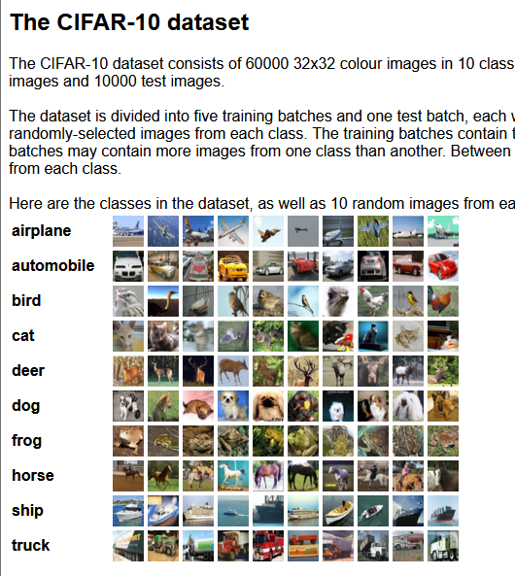
Which Dataset was chosen?
Already worked on from previous exercises
Chosen for practical reasons and bigger size

Slide 4
Data Preprocessing
CIFAR-10 Dataset (60k images)
1 - Loaded the CIFAR-10 dataset
(60,000 color images, 32×32×3, across 10 classes).
2 - Converted pixel values from [0, 255] to [0, 1].
3 - Converted numeric class labels (0–9) into one-hot vectors (e.g., dog → [0,0,0,0,0,1,0,0,0,0])
4 - Display sample images to verify correct data loading and labeling.
Image Normalization (Pixel values / 255)
Label Encoding (One-hot vectors)
Data Visualization (Check samples)

Slide 5
Model Architecture
Model | Description | Architecture | Results
M1 | Baseline CNN | • 1 Conv2D layer (32 filters) • MaxPooling2D • Flatten → Dense(100) → Dense(10, softmax) • Optimizer: Adam (1e-3) | acc: 0.66 L: 1.08
M6 | Deep CNN with Regularization | • 6 Conv2D layers (64–128–256 filters) • GlobalAveragePooling2D (instead of Flatten) • Dropout(0.3) between dense layers • Adam (1e-2), batch size 128 | acc: 0.10 L: 2.30
M11 | CNN with Data Augmentation & L2 Regularization | • Added data augmentation (padding, crop, flip) • BatchNormalization after each Conv layer • L2 weight decay (5e-4) • Dropout(0.4–0.5) • SGD with cosine learning rate schedule + warmup | acc: 0.928 L: 0.76
M13 (Winner) | Transfer Learning with MobileNetV2 | • MobileNetV2 backbone + GlobalAveragePooling2D • Two-phase training: head warm-up then fine-tuning • Extensive data augmentation • SGD + cosine LR schedule | acc: 0.934 L: 0.20
M14 | Model SUPREME — “Wide ResNet-28-10 (MixUp Edition) | • Wide ResNet-28-10 — 28 layers deep, 10× wider than the original ResNet-28 | acc: 0.939 L: 0.37

Slide 6
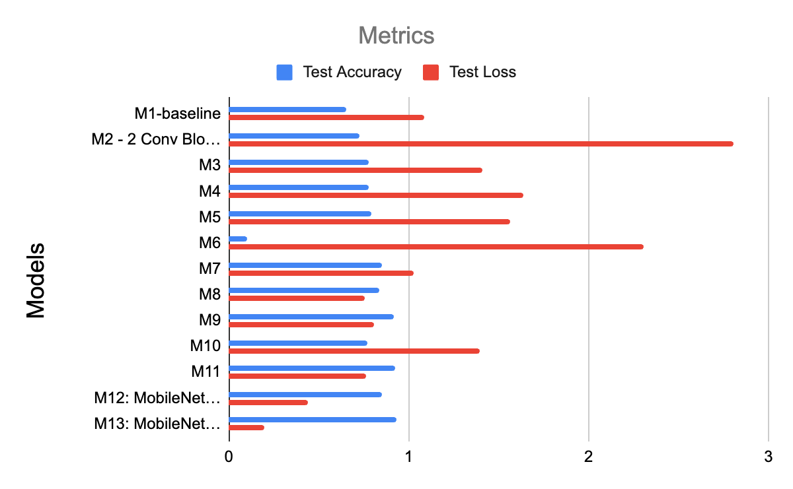
Model Performance

Slide 7
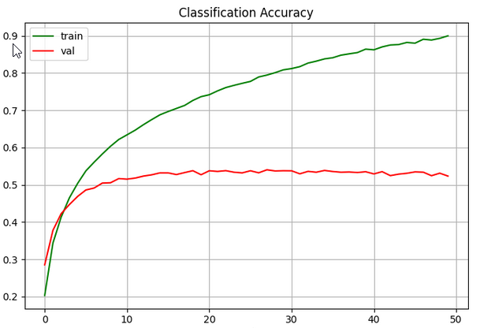
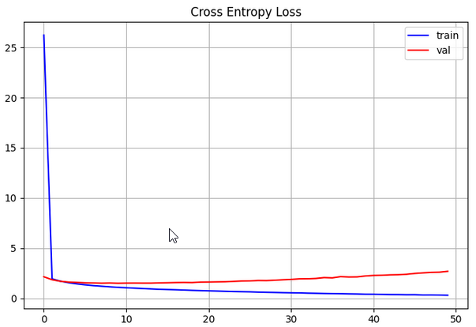
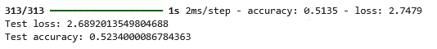
Model 1
Simple structure:
1 Conv layer → Pooling → Dense layers
Served as the initial performance benchmark
Achieved ≈ 66% accuracy
Showed that even a small CNN can learn basic image features

Slide 8
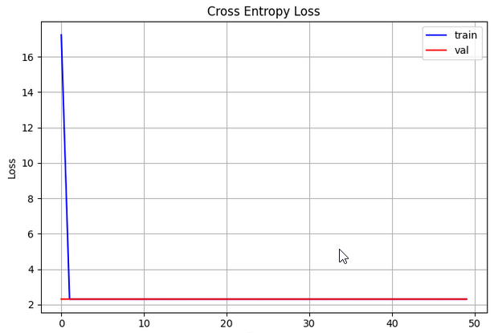
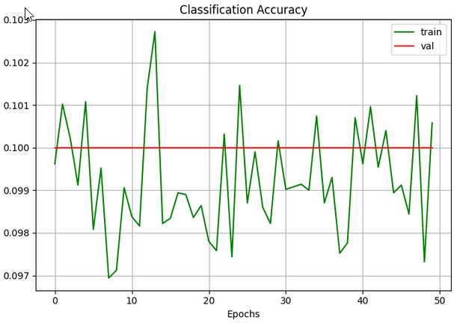
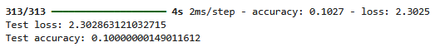
Model 6
Increased depth: added more Conv layers + Dropout
Raised learning rate (too high) → unstable training
Accuracy ≈ 10%, Loss ≈ 2.3 (random performance)
Revealed that depth ≠ better results
Key lesson: lower learning rate and use proper regularization
Became our most educational failure

Slide 9
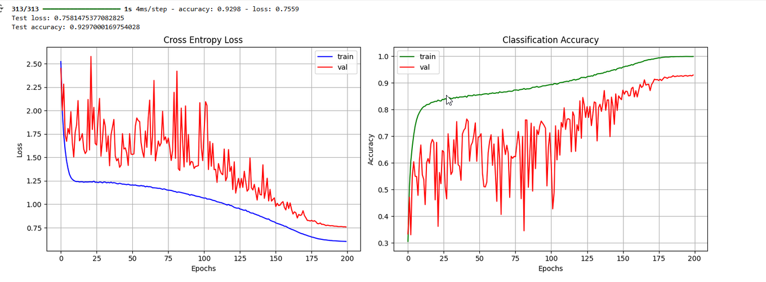
Model 11
Added Batch Normalization, Data Augmentation, L2 Regularization, and Dropout
Implemented Cosine Learning Rate Schedule for smoother training
Significantly improved stability and generalization
Achieved ≈ 90–92% accuracy

Slide 10
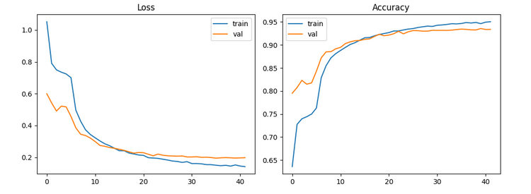
Model 13
Used MobileNetV2 pretrained on ImageNet
Fine-tuned for our dataset to leverage learned features
Achieved ≈ 94% accuracy — best overall performance
Efficient training with strong generalization
Demonstrated our progression from simple to advanced models
Showed how regularization and transfer learning lead to a more powerful, reliable CNN

Slide 11
Model Train OR Optimization Techniques Used
🗣️ What to say:
“We began with Adam for quick convergence during experimentation, then switched to SGD with momentum and Nesterov for better long-term generalization and smoother training curves.”
Adam
Model 13 with Adam and SGD
Models
1, 2, 3, 5, 6, 7, 8, 12
SGD
Models
4,9,10,11

Slide 12
Transfer Strategies Used
Model 12:
Single-Phase transfer
Pre-training of MobileNetV2
Standard 1e-3
Optimizing with Adam
Model 13:
Two-Phase transfer
Pre-training of MobileNetV2
Pre-trained dataset explicitly frozen first, then half unfrozen later
Two-Phase 1e-3(head) ran 5 epochs and then 50 epochs on small cosine LR for fine-tuning.
Optimizing with SGD, momentum and cosine schedule
Notes:
M12= Transfer learning is fast and easy but it has limited adaptation.M13= starts with safe then carefully fine tunes for best results

Slide 13
Optimization Techniques
Techniques we tried out:
✅ MixUp - This is your main defense. It's incredibly effective at preventing overfitting ✅ Weight decay (5e-4) - L2 regularization on all conv layers ✅ Data augmentation - Flips, translations, zoom, crops ✅ Dropout (0.3) - Applied in residual blocks ✅ Early stopping (patience=30) - Will catch runaway overfitting

Slide 14
Recap and Key Takeaways
1. More Parameters ≠ Better Results (Efficiency Matters)
2. Transfer Learning is a Cheat Code (Use It!)
3. Overfitting is Real, But Manageable
4. MATCH YOUR PREPROCESSING TO HOW THE MODEL WAS TRAINED!
5. Data Augmentation: More ≠ Better

Slide 15
Deployment - Demo
Gradio
link

Slide 16
Learnings
More time to work on the project
Better teamwork
Time to experiment
Design a lot of models
Iterate the models
Achieve results
Learned about CNN and how to build them
Learned about different model architecture styles
Learned about different Optimizers like SGD and Adam
Learned about Learning Rate
Learned about Transfer Learning

Slide 17

THANK
YOU!

Slide 18
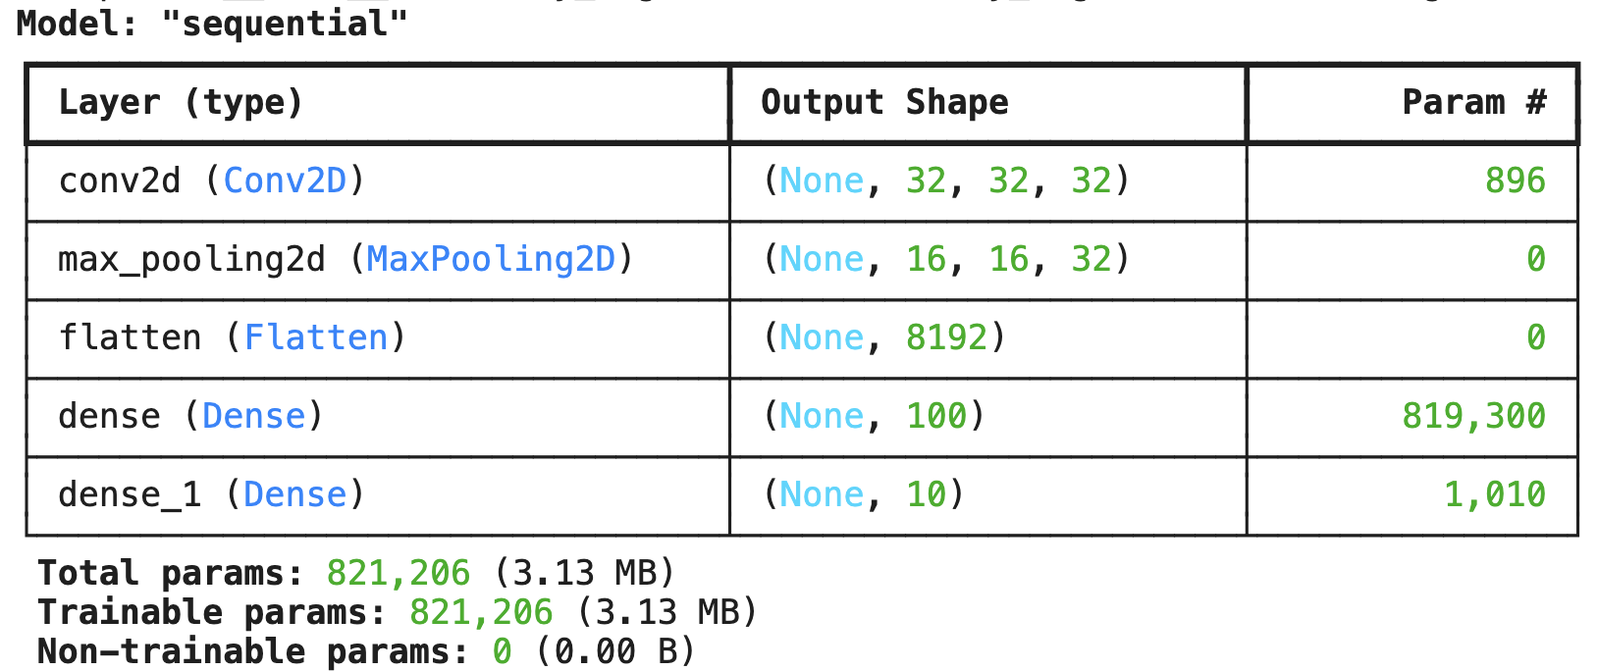
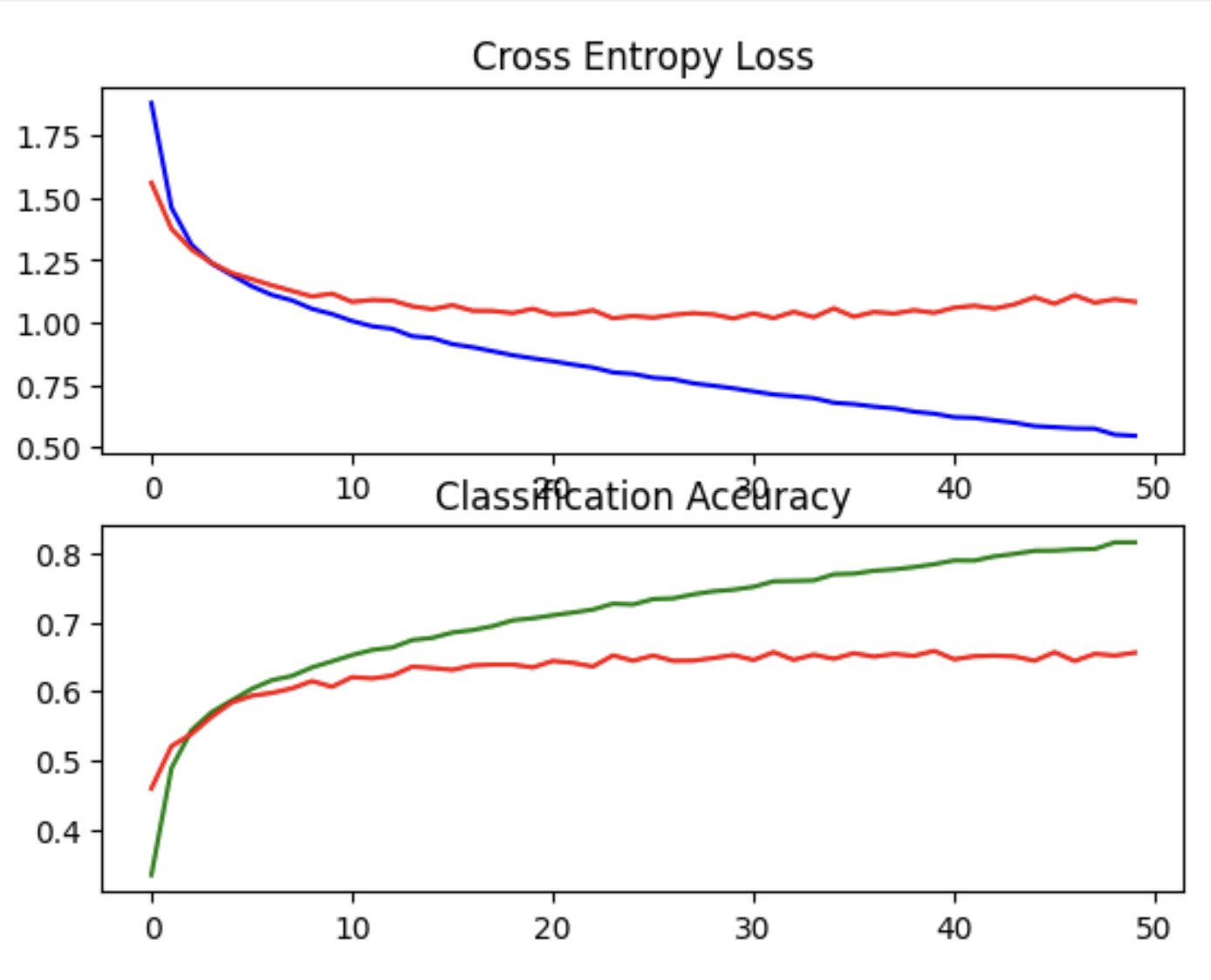
M1 Baseline with 1 Convolutional Layer
- Model with low accuracy.

Slide 19
M1 Baseline with 1 Convolutional Layer
- Model with low accuracy.

Slide 20
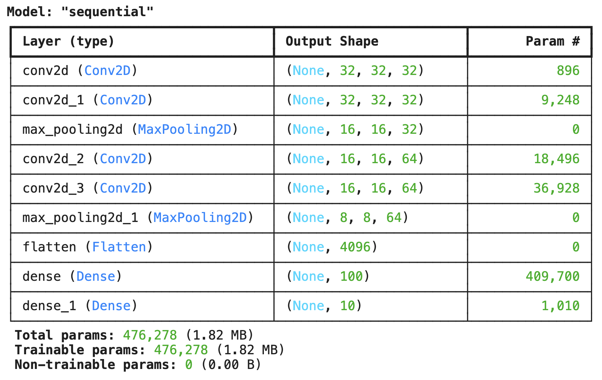
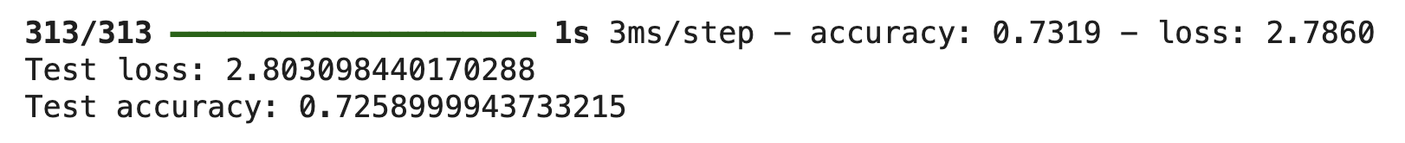
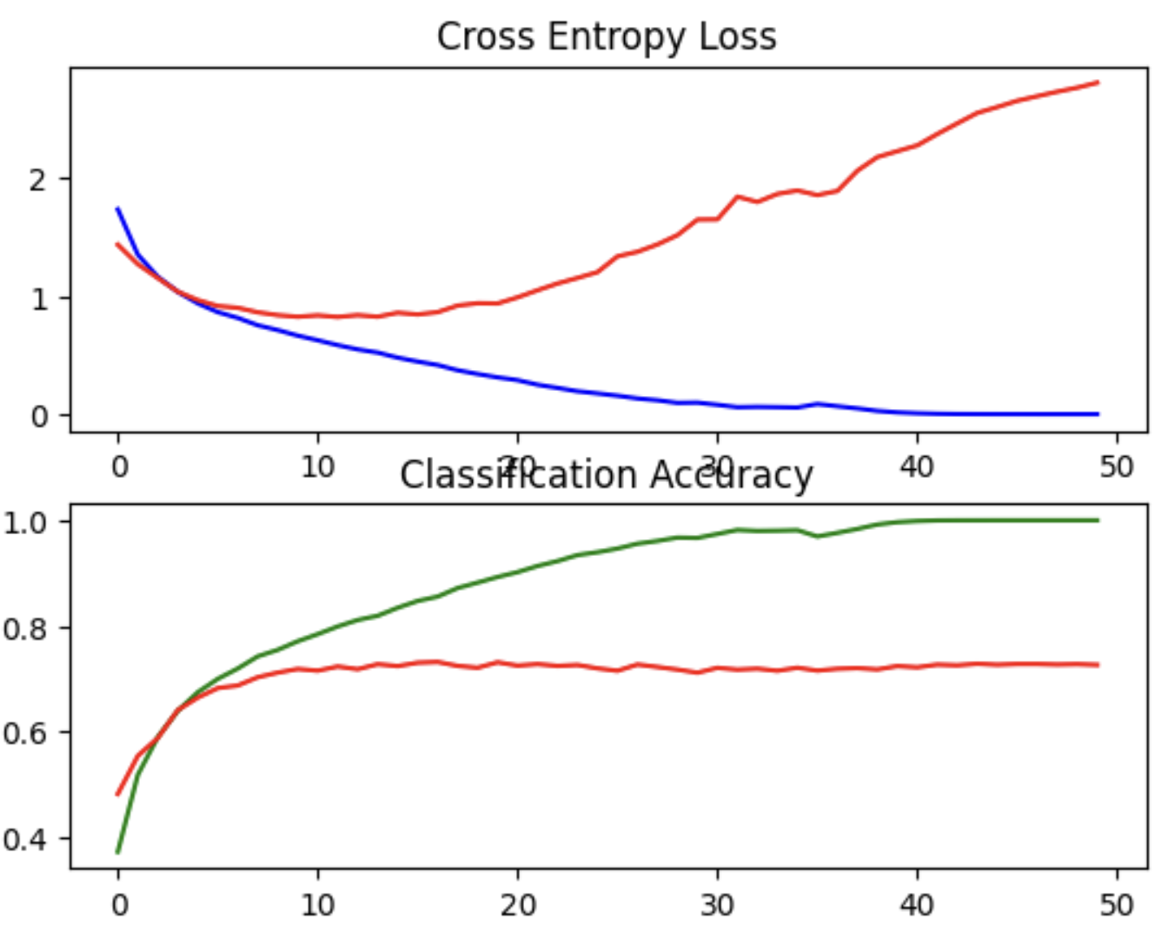
M2 - Model with 4 Convolutional Layers
- Here we increased the number of convolution layers
- We gained on accuracy, but on the expanse of the loss.

Slide 21
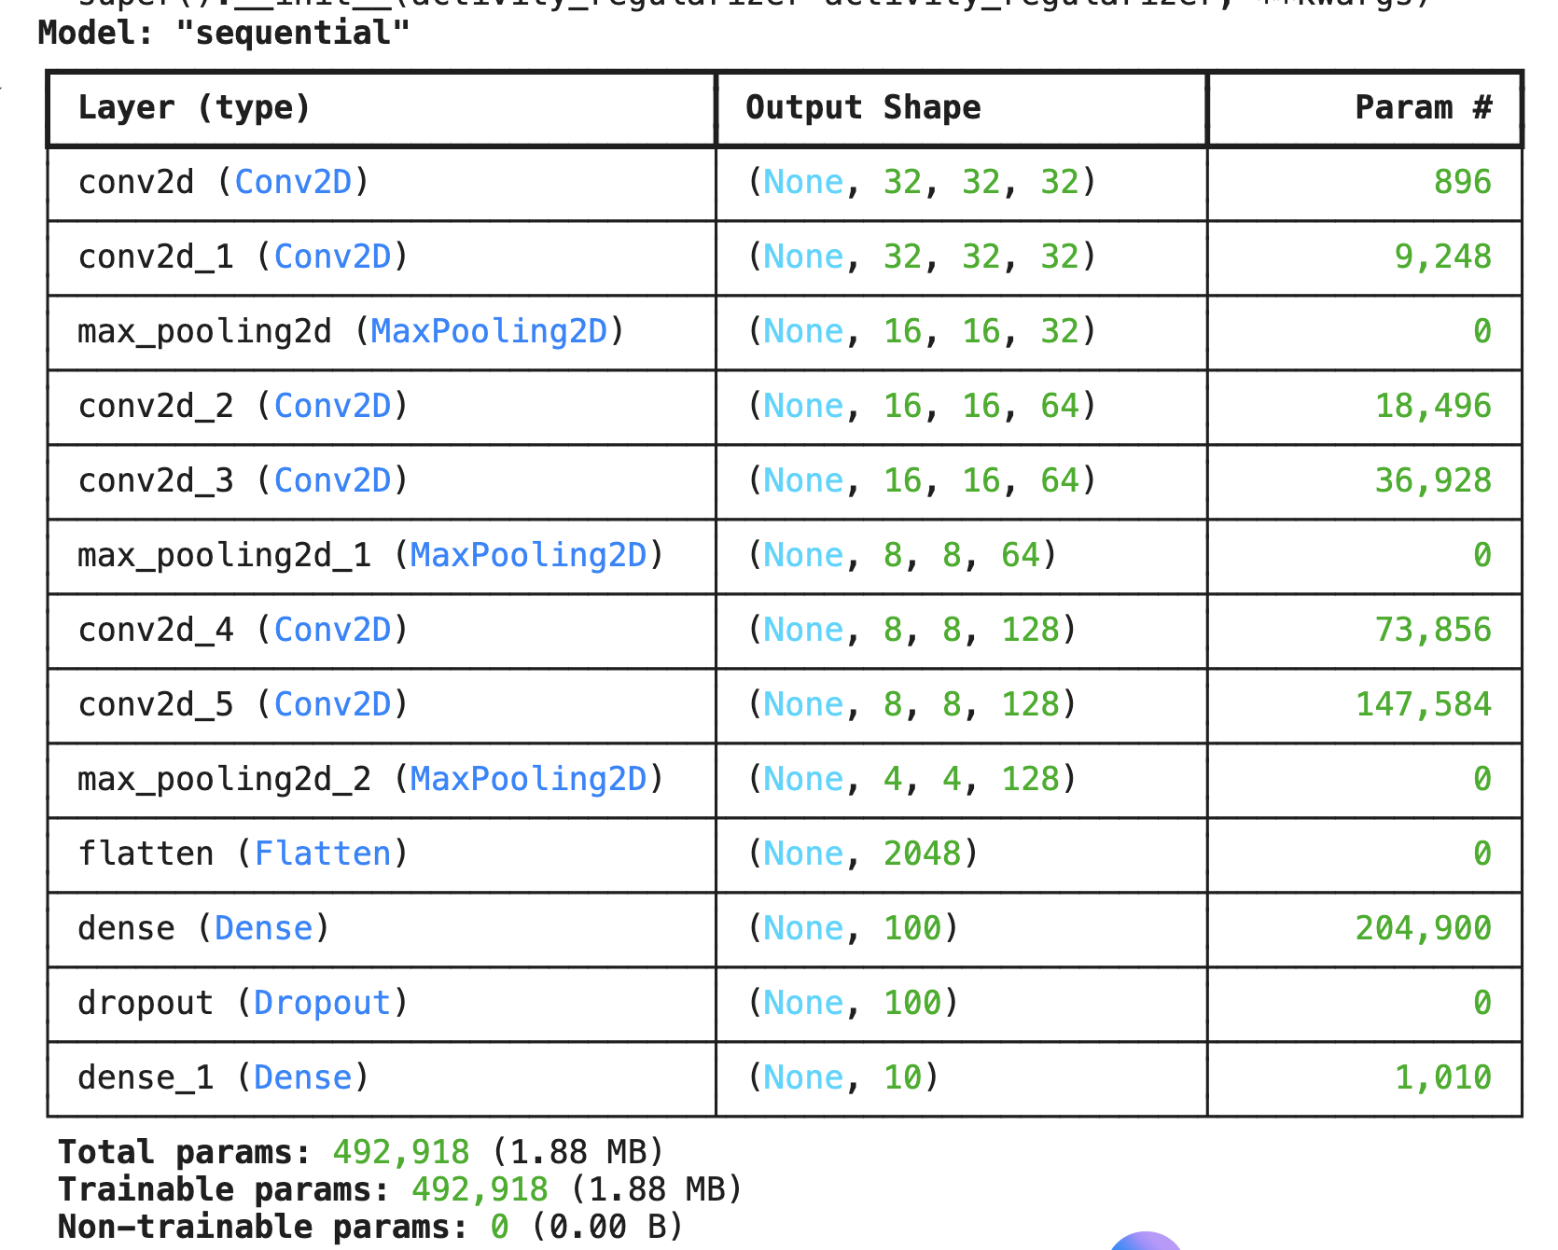
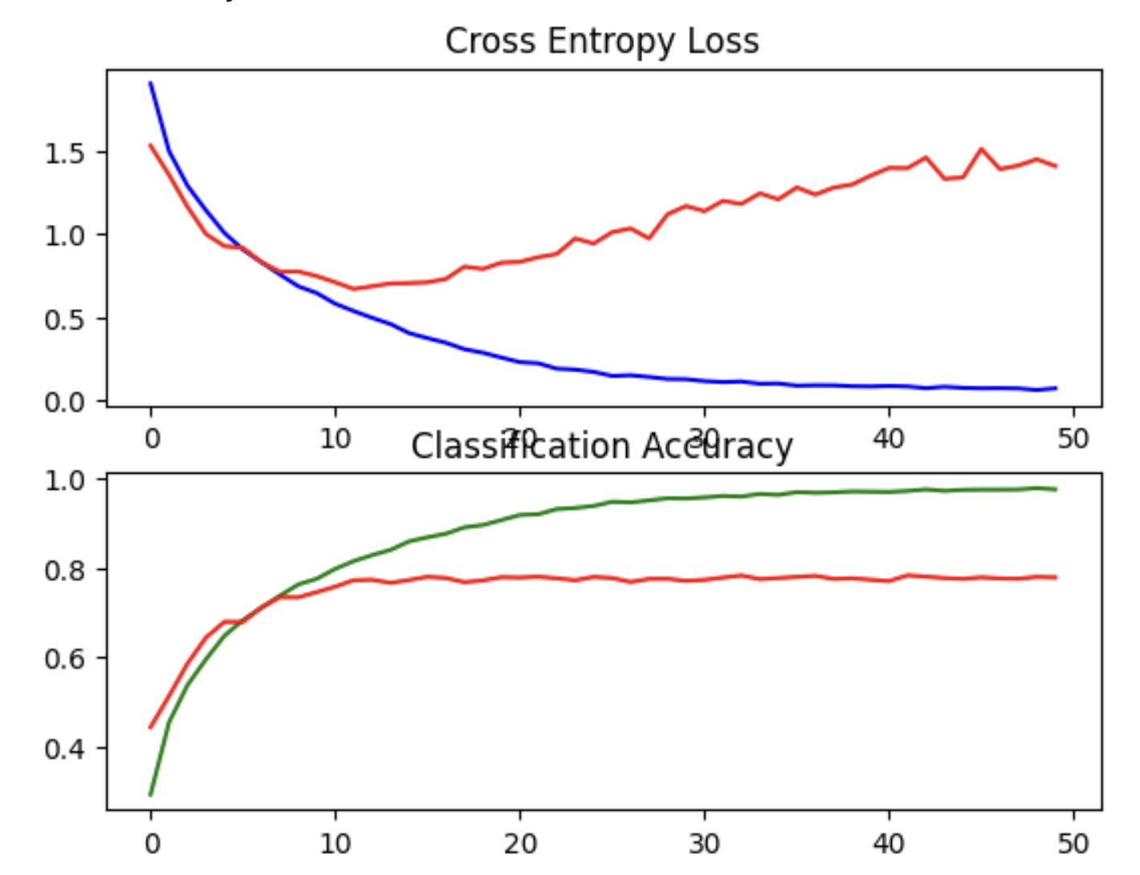
M3 - Model with 6 Convolutional Layers
- Here we introduce more layers and suppose it might overfit, that's why we introduce Dropout
- The loss is less, the accuracy better,
so better than M2

Slide 22
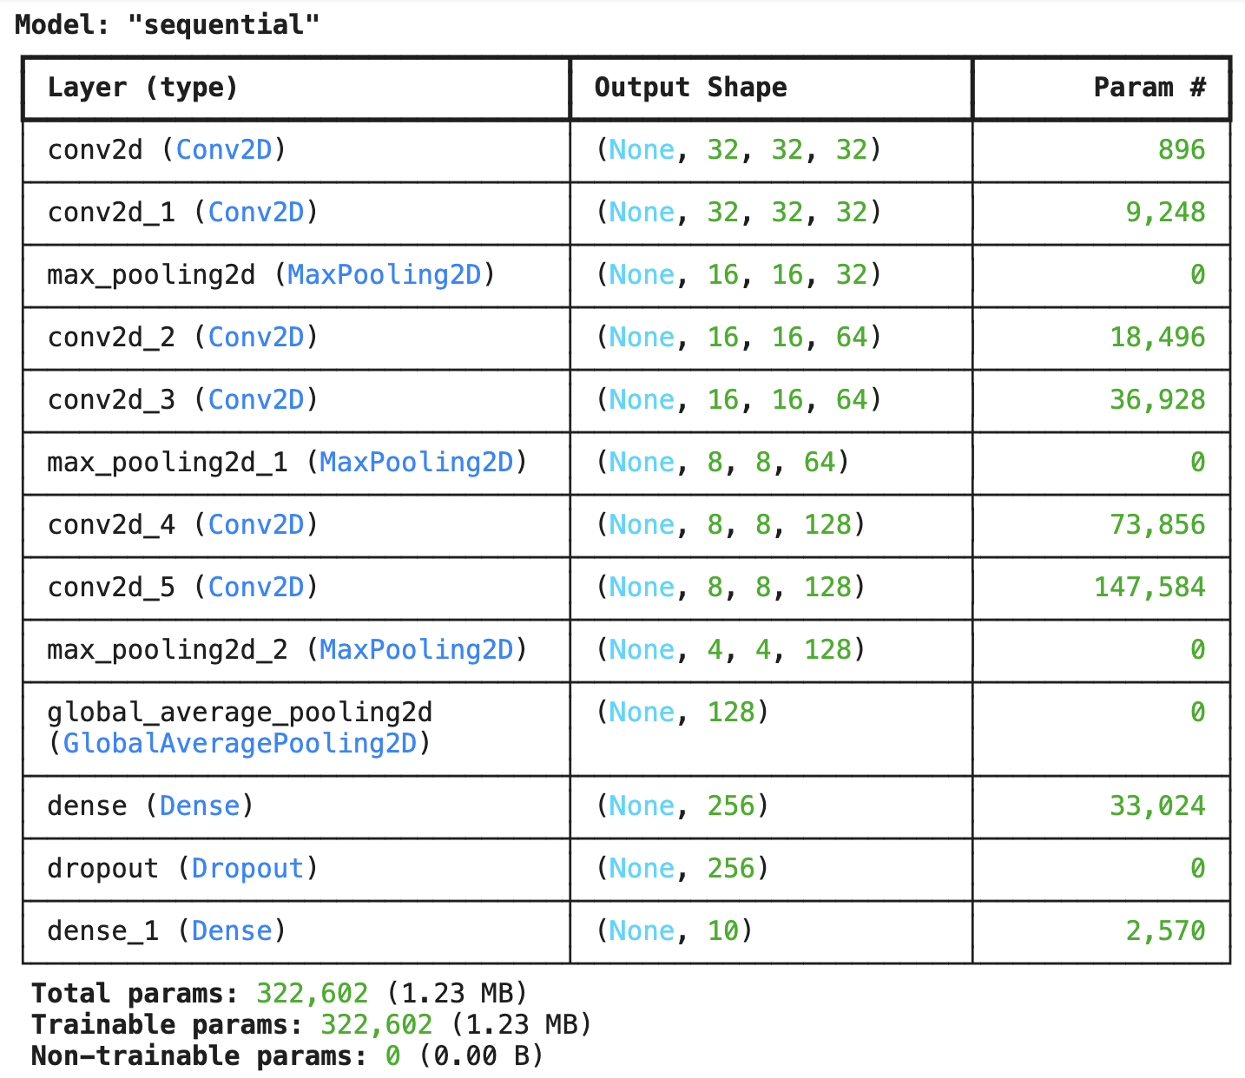
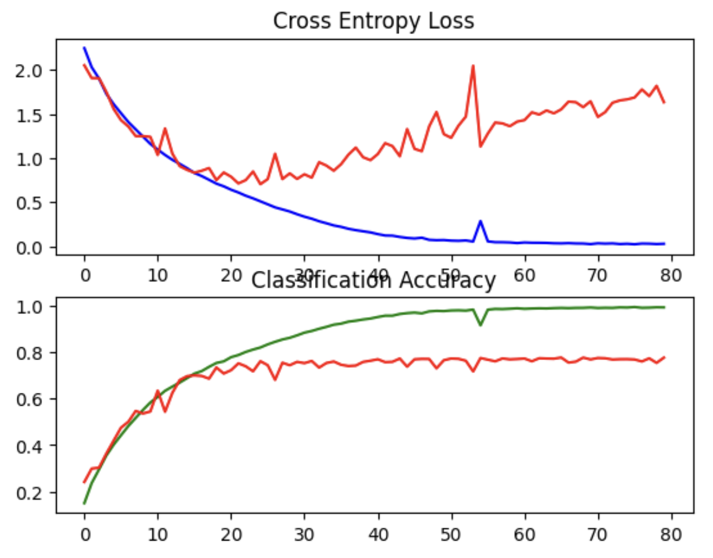
M4 - Model with Optimizer SGD instead of Adam
- Here we are going to use SGD as an optimizer with 80 Epochs, and decrease the batch_size from 512 to 128
- Here instead of Flatten() use GlobalAveragePooling2D()
- Decrease in accuracy plus bigger loss

Slide 23
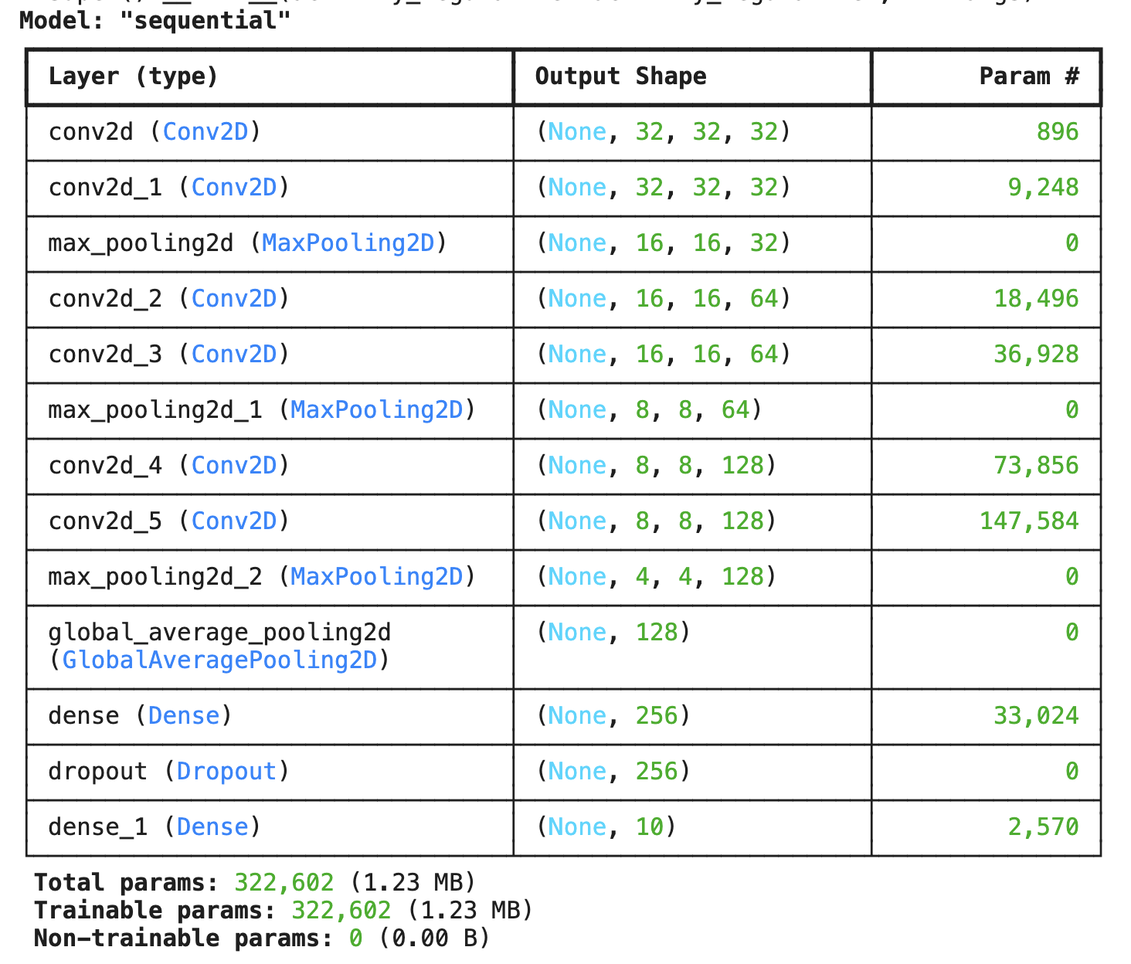
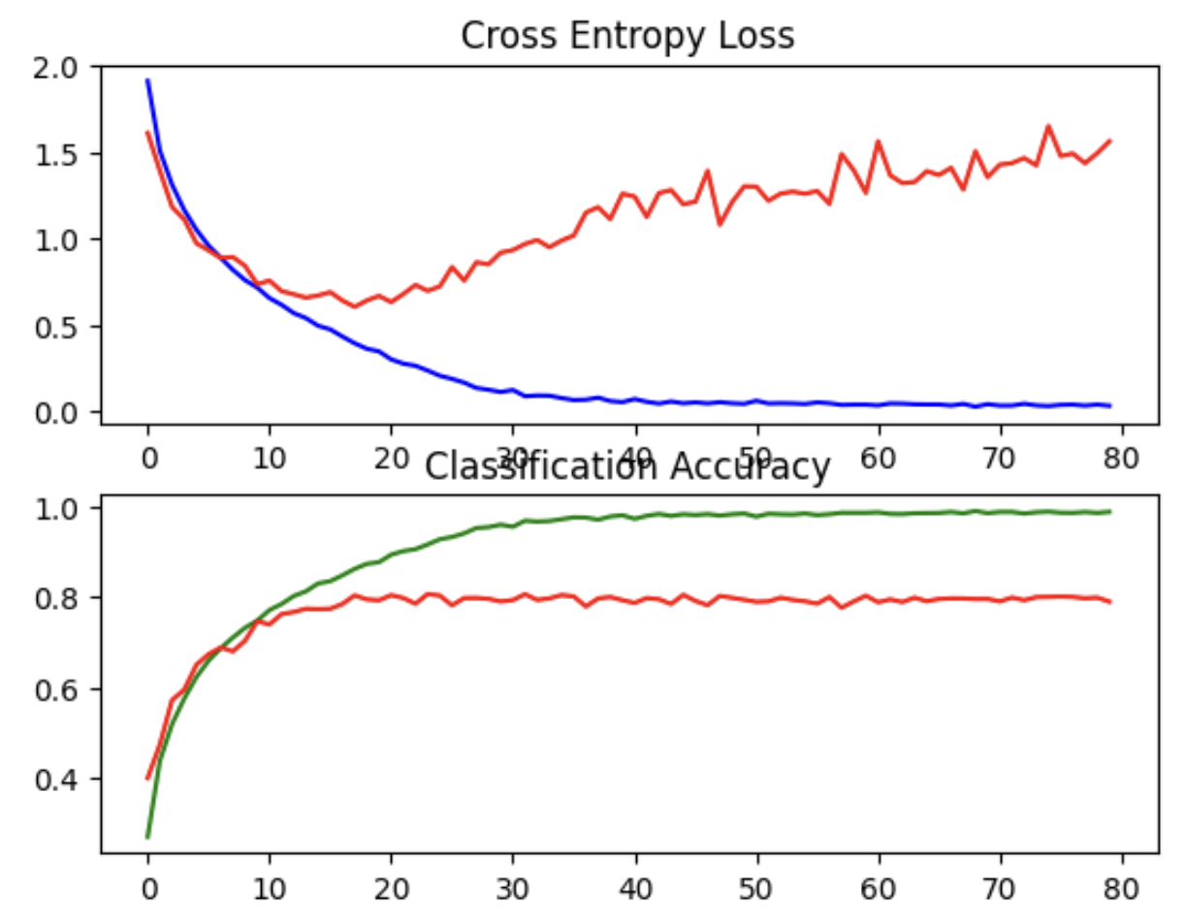
M5 - Model with Optimizer Adam instead of SGD
- Here we only changed the optimizer from SGD to Adam and the results improved in comparison to M4. So we keep using Adam for the next models

Slide 24

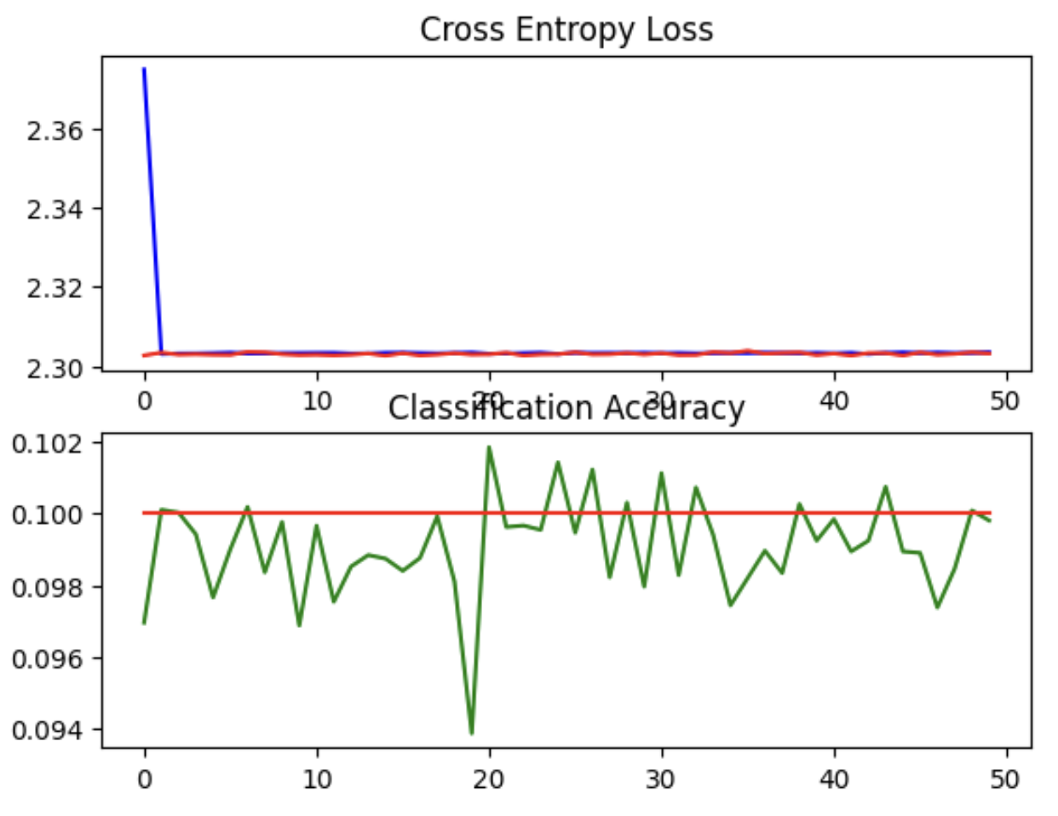
M6 - Doubling 6 Convolutional Layers + Increasing the LR
- Doubling the convolution layers
- Increasing the learning rate decreased accuracy drastically, so we need to go in the exact opposite direction by decreasing the learning rate

Slide 25
M7 - Doubling 6 Convolutional Layers+Decreasing the LR
- Decreasing the learning rate delivered better results

Slide 26
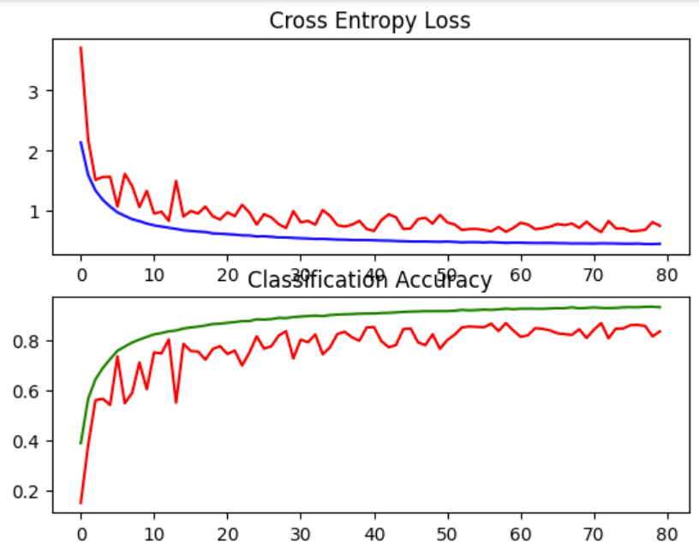
M8 -
Application of:
ZeroPadding2D
RandomCrop
RandomFlip
Batch Normalization
Kernel regularizer

Slide 27
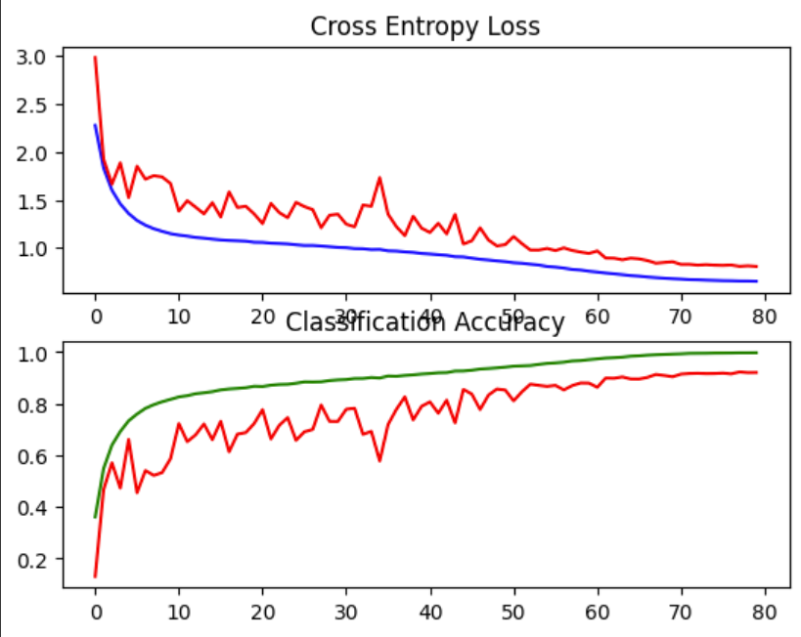
M9 -
Application of:
SGD
smoothing (“reducing noise”)
nesterov
Early stopping

Slide 28
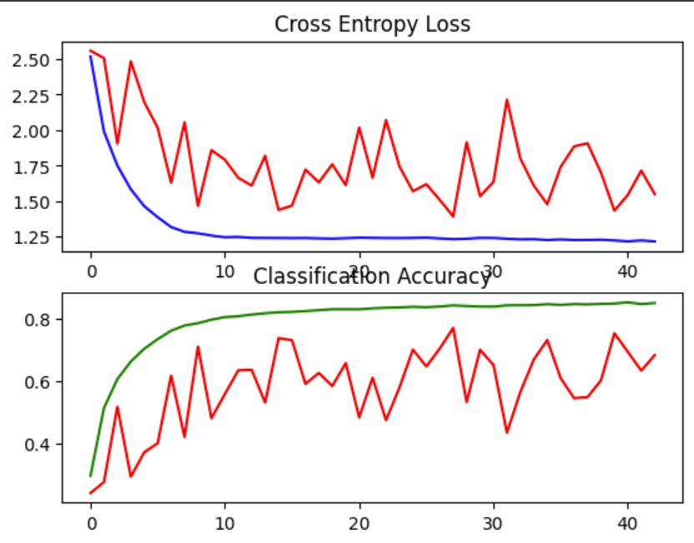
M10 -
Application of:
Change of verbose from 1 to 2
Lambda
Warmup Cosine
Early stopping

Slide 29
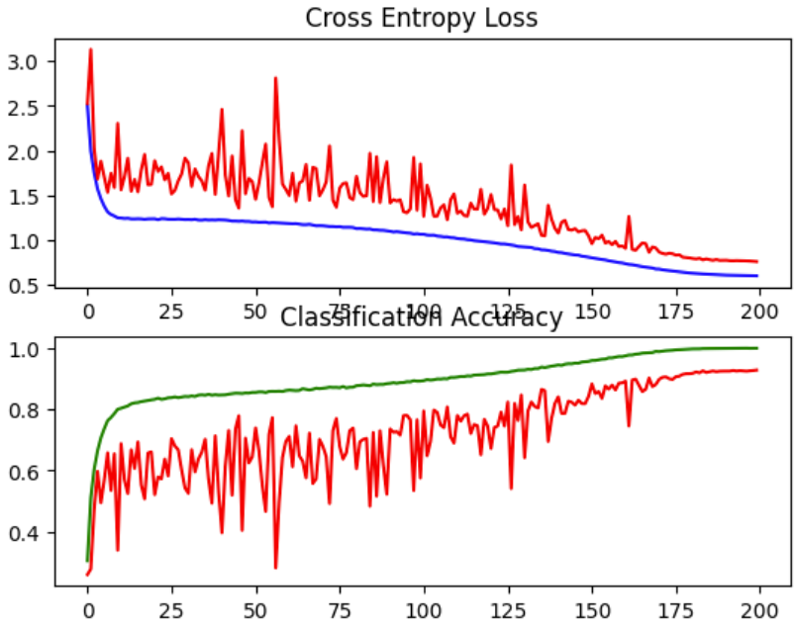
M11 -
Dismissal of:
Early Stopping

